Slide 1
Tree Problem Solving - I (Intermediate)

Slide 2
















































Copying a binary tree

Slide 3
































Mirror Mirror: Given a binary tree, convert it into its mirror.
Sample Input:
10
/ \
20 30
/ \
40 60
Sample Output:
10 10
/ \ Mirror / \
20 30 —> 30 20
/ \ / \
40 60 60 40

Slide 4
Tree Problem Solving - II (Intermediate)

Slide 5























































2. Level min: [7 Marks]
Given a binary tree, find the smallest value in each level.
Sample Input: [You can use dictionary here]
4
/ \
2 9
/ / \
7 3 -5
Sample Output: 4 2 -5
Explanation:
There are 3 levels in the tree
Level 0: {4}, min= 4
Level 1: {2, 9}, min= 2
Level 2: {7, 3, -5}, min = -5

Slide 6








































Slide 7
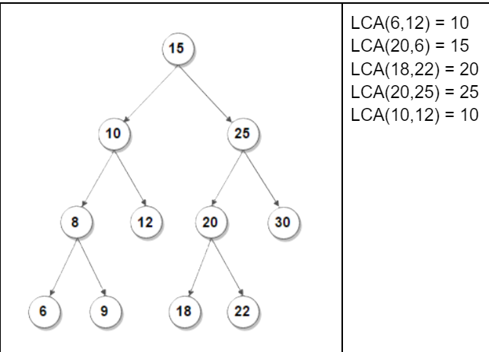










4. Find the Lowest Common Ancestor (LCA) of two nodes in a BST [8 Marks]
The lowest common ancestor (LCA) of two nodes x and y in the BST is the lowest (i.e., deepest) node that has both x and y as descendants. In other words, the LCA of x and y is the shared ancestor of x and y that is located farthest from the root.
Corner Case: if y lies in the subtree rooted at node x, then x is the LCA; otherwise, if x lies in the subtree rooted at node y, then y is the LCA.

Slide 8

























Slide 9
Tree Problem Solving – III
Find the Lowest (Deepest) Common Ancestor of a Binary Tree

Slide 10































4. Find the Lowest Common Ancestor (LCA) of two nodes in a BST [8 Marks]
The lowest common ancestor (LCA) of two nodes x and y in the BST is the lowest (i.e., deepest) node that has both x and y as descendants. In other words, the LCA of x and y is the shared ancestor of x and y that is located farthest from the root.
Corner Case: if y lies in the subtree rooted at node x, then x is the LCA; otherwise, if x lies in the subtree rooted at node y, then y is the LCA.

Slide 11

































































Slide 12





